Slide 1
Women Writers in the 17th century

Slide 2
17th cetury – first authorship and publication by women
Marriage, gender, partiarchy
Most of them are from noble class, got well education

Slide 3
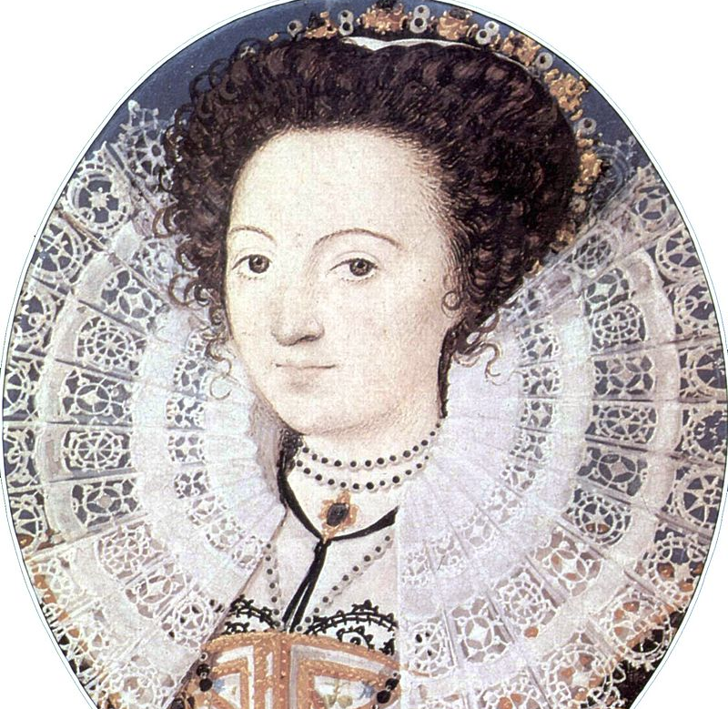
Aemelia Lanyer (1569-1645)

Slide 4
Women publishing considered unusual.
First collection of poetry, and attempted to find a patron
Salve Deus Rex Judaeorum

Slide 5
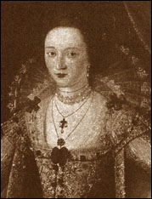
Mary Wroth (1578-1651?)
The Countess of Montgomery’s Urania
A romance
Pamphilia to Amphilantus
Sir Philip Sidney is her uncle

Slide 6
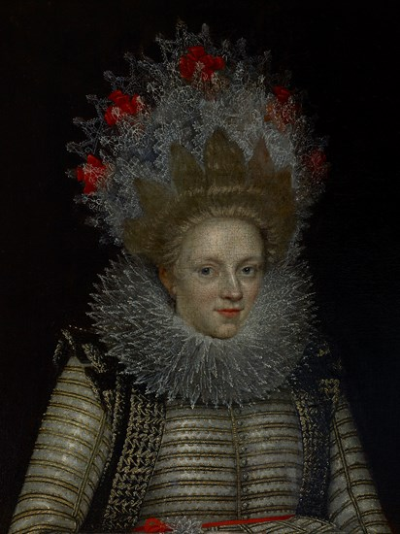
Elizabeth Cary
The Tragedy of Miriam
First drama written and published by a woman
Queens insisting on preserving their

